Slide 1
Cambridge IGCSE®
The world’s most popular international qualification for 14 to 16 year olds
Keith Lucey Senior School Development Manager Oct 2018

Slide 2
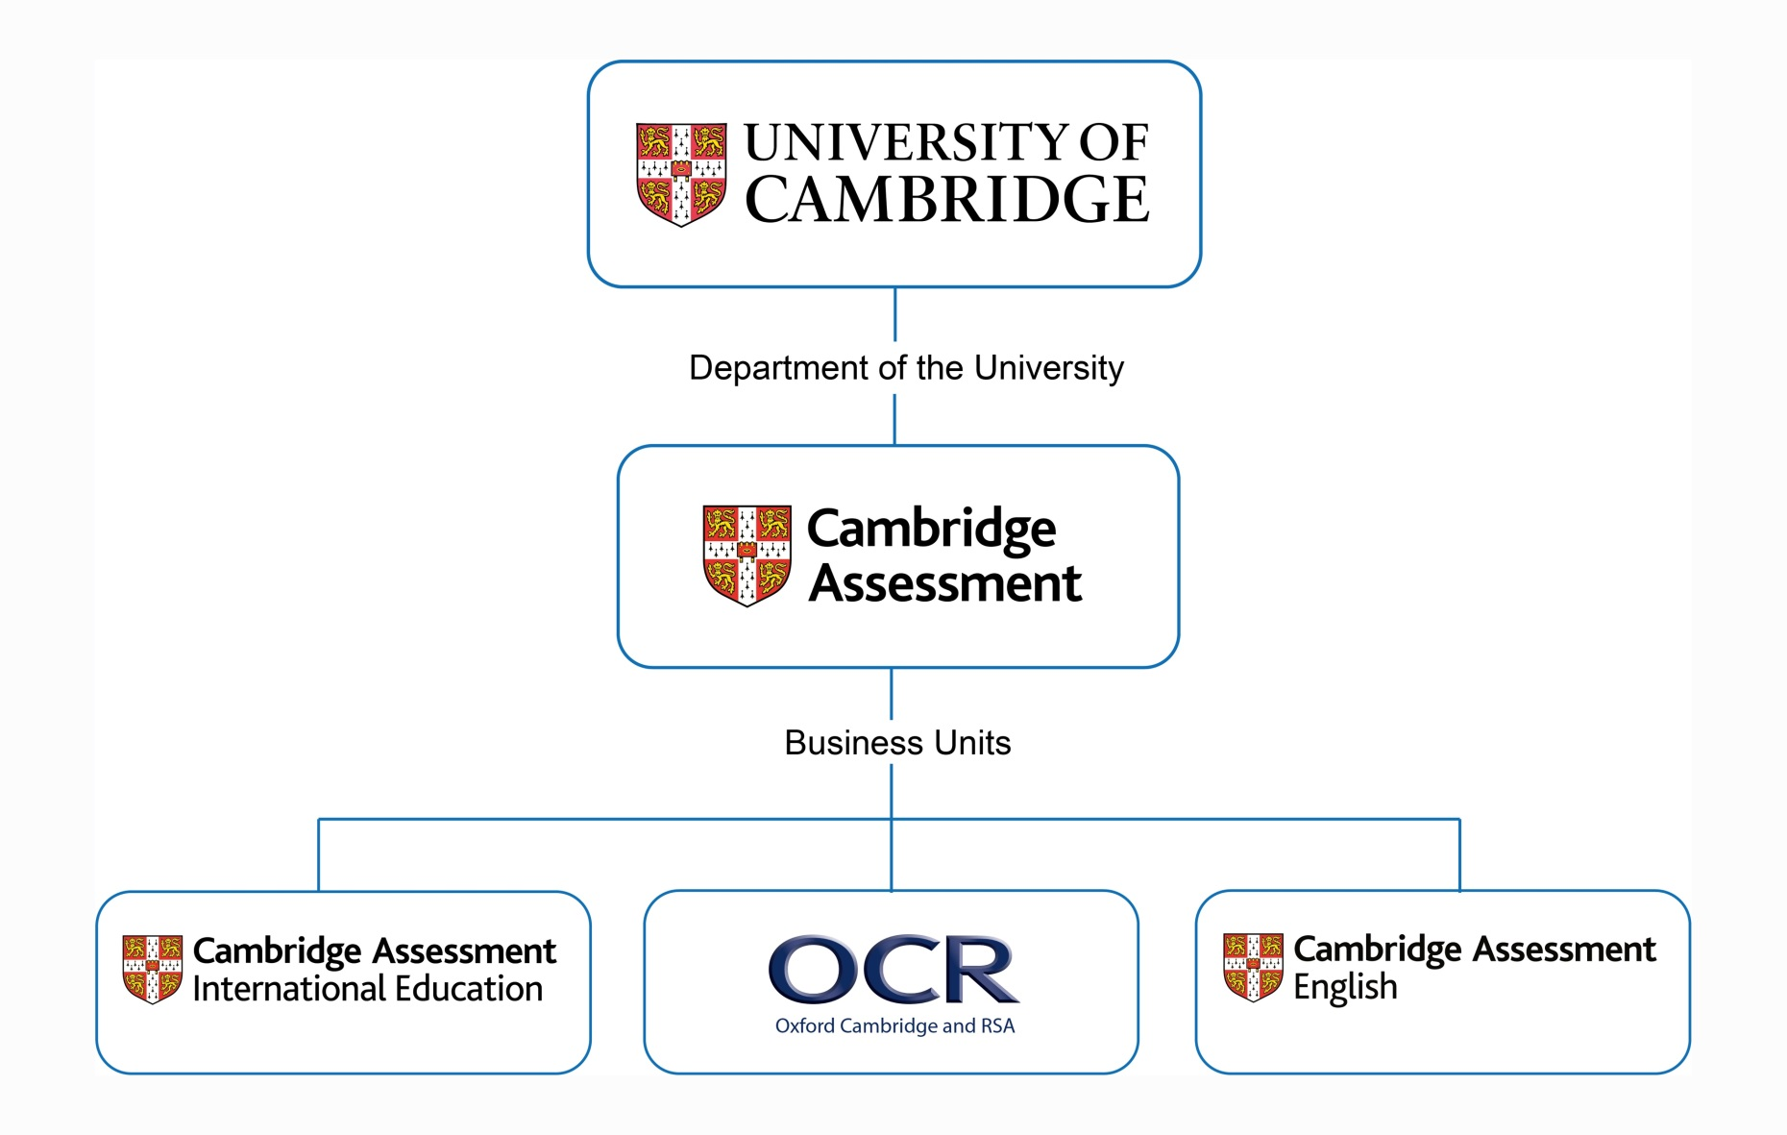
The Cambridge Assessment Group
Notes:
Cambridge Assessment International Education (Cambridge International for short) is part of the Cambridge Assessment Group, a not-for profit department of the University of Cambridge. We are proud to be part of one of the oldest and greatest universities in the world - renowned worldwide for excellence in education.
The Cambridge Assessment Group operates and manages the University’s three exam boards:
Cambridge Assessment International Education- the world’s largest provider of international education programmes and qualifications for 5 to 19 year olds
Oxford Cambridge and RSA Examinations (OCR for short) - a leading UK awarding body, committed to providing qualifications that engage learners of all ages at school, college, in work or through part-time learning programmes to achieve their full potential
Cambridge Assessment English – provider of the world’s leading range of certificates for learners of English.

Slide 3
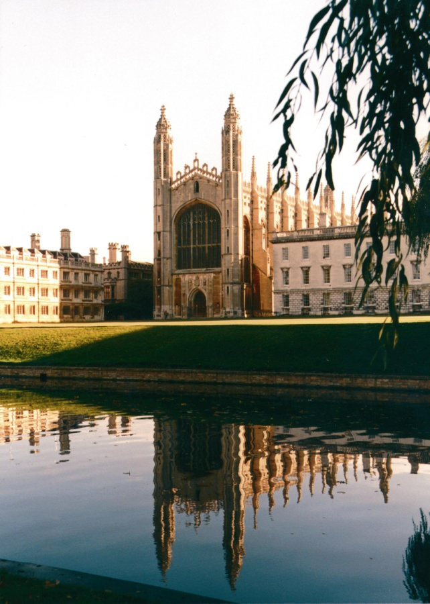
Cambridge International Assessment
Part of the University of Cambridge –a non-profit renowned worldwide for excellence in education
World’s largest provider of international education for over 150 years
Working with over 10,000 schools, 170 countries & 40 governments
We prepare school students for life, helping them develop an informed curiosity and a lasting passion for learning
Notes:
Cambridge International Examinations is part of the University of Cambridge, which celebrated its 800th anniversary last year.
Cambridge International Examinations is also part of Cambridge Assessment – founded over 150 years ago. Today, Cambridge Assessment is an organisation of 1500 people, and Cambridge International Examinations is a vital part of its international educational expertise and assessment research. Our sister organisations within Cambridge Assessment are OCR (Oxford Cambridge and RSA) which offers qualifications for schools here in the UK and Cambridge English Language Assessment, which provides exams testing English language skills among speakers of other language. Research is at the heart of everything we do - the reliability of our assessment comes from our evidence-based and research-led approach to all developments. And so of course we have our own assessment research division, the largest research capability of its kind.
Because we belong to the University of Cambridge, we are a charitable foundation. We invest any return from our activities into education and research.
Cambridge International Examinations is the world’s largest provider of international education for 5-19 year olds.

Slide 4
What is IGCSE
International General Certificate of Secondary Education

Slide 5
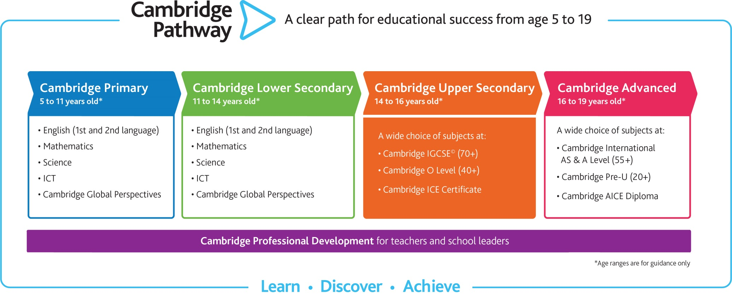
Cambridge Upper Secondary
Notes:
Cambridge Upper Secondary is typically for learners aged 14 to 16 years.
It builds on the foundations of Cambridge Lower Secondary, although it is not essential to have completed that stage before beginning Cambridge Upper Secondary.
Cambridge Upper Secondary includes:
Cambridge IGCSE – the world’s most popular international qualification for 14 to 16 year olds
Cambridge O Level, which has been designed especially for an international audience.
Both provide excellent preparation for Cambridge Advanced and for progression to other educational systems.
Syllabuses support schools by using learner-centred and enquiry-based approaches to learning. They describe the knowledge, understanding and skills learners will develop and explain how these will be assessed.

Slide 6
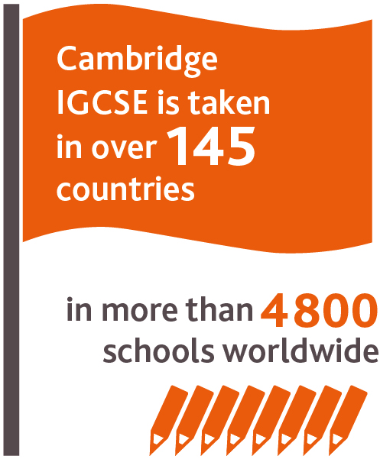
Cambridge IGCSE®
The world’s most popular international qualification for 14 to 16 year olds.
Over 70 subjects, including 30 languages
Develops learner knowledge, understanding and skills
International in outlook with local relevance
Provides excellent preparation for Cambridge Advanced and for progression to other educational systems.
Enables a variety of routes for all abilities, including those whose first language is not English
Compatible with other curricula.
Notes:
Cambridge IGCSE is the world’s most popular international qualification for 14 to 16 year olds.
We developed the International General Certificate of Secondary Education (IGCSE) over 25 years ago. It is taught by over 4800 schools in 146 countries.
The curriculum offers a variety of routes for learners with a wide range of abilities, including those whose first language is not English.
It develops learner knowledge, understanding and skills in:
subject content
applying knowledge and understanding to familiar and new situations
intellectual enquiry
flexibility and responsiveness to change
working and communicating in English
influencing outcomes
cultural awareness.
The syllabuses are international in outlook, but retain a local relevance. They have been created specifically for an international student body with content to suit a wide variety of schools and avoid cultural bias.
Schools worldwide have been, and continue to be, involved in the development of Cambridge IGCSE, so we are confident it represents the best possible international education for 14 to 16 year olds. The content, the structure and the administrative support mean Cambridge IGCSE answers the needs of more and more schools worldwide.

Slide 7
IGCSE
IGCSE Subjects
Choose from over 70 subjects, in almost any combination.
IGCSE Subjects
Accounting Agriculture Arabic Art and Design Biology Business Studies Chemistry Child Development Chinese Co-ordinated Sciences Combined Science Computer Studies Design and Technology Development Studies Drama Economics | English (First Language) English (Second Language) English Literature Environmental Management Food and Nutrition French Geography German Greek Hindi History Information Technology | Italian Japanese Latin Mathematics International Mathematics Mathematics (Additional) Music Physical Education Physics Religious Studies Sociology Spanish Travel and Tourism
Notes:
Cambridge English - Develop the ability to communicate clearly, accurately and effectively.
Cambridge First and Foreign Languages - Helps students understand and respond to what they read and hear
Cambridge IGCSE Mathematics - An essential subject for all learners, syllabuses encourage the development of mathematical knowledge as a key life skill.
Cambridge Sciences – emphasizes theory and real life applications, impact of research on individuals and society and development of practical skills.
Cambridge Arts & Humanities – Enables students to develop deeper insights. Provides a wider perspective on social issues and cultures around the globe
Cambridge Business, Vocational and Technical subjects – theory and real world applications

Slide 8
IGCSE Assessment
Our assessments are designed to be fair, valid, reliable and practicable.
At the end of the course
Gives schools different options
Maximises opportunities for learners
Benchmarks learners’ performance – eight grades
Clear guidelines
Tiered structure
Notes:
We assess what we believe to be of value: the combination of cognitive skills and content knowledge which constitutes subject understanding.
Assessment takes place at the end of the Cambridge IGCSE course.
Cambridge IGCSE provides schools with different options to suit their learners e.g. written, oral, coursework and practical assessment. The assessments maximise opportunities for learners to show what they can do, and is sensitive to learners whose first language may not be English throughout the examination process.
Grades are benchmarked using eight internationally recognised grades, which have clear guidelines to explain the standard of achievement required for different grades.
Cambridge IGCSE offers a tiered structure in many subjects for different ability levels, learners of all abilities are assessed positively and bright individuals have the chance to excel.

Slide 9
IGCSE Core vs Extended
Core
Highest possible grade is a C
Often taught over 1 academic year
Extended
Highest possible grade is an A*
Requires deeper depth of understanding than Core
Typically has more content than Core
Often taught over 2 academic years
*It is important to remember that there is no standardized way to deliver
the IGCSE courses

Slide 10
How about some US context

Slide 11
Cambridge Qualifications in the US

Slide 12
IGCSE & A/AS in the United States
Yes. Public and Private schools in the US offer IGCSE and A/AS courses
IGCSE typically given in 9th and 10th grade
Many Schools will teach the course but not sit for the exam
A/AS Courses
Students will sit for the exam
Receive college credit for a passed exam

Slide 13
Cambridge IGCSE Grades
Cambridge IGCSE grade | Suggested US equivalent grade
A* | A+, A
B | A-, B+
C | B
D | C+
E | C
F | D+
G | D
U | F

Slide 14
Arizona Grand Canyon Diploma

Slide 15
Cambridge IGCSE English
Available for learners whose first language is English
Develop the ability to communicate clearly, accurately and effectively
Encourages an appreciation for literature
Subjects
English – First Language English – Second Language English Literature World Literature
Notes:
Cambridge IGCSE English syllabuses are available for learners whose first language is English and for those with good English skills, but who are not native speakers.
The syllabuses develop the ability to communicate clearly, accurately and effectively in both speech and writing, for study and employment. The literature syllabuses encourage an appreciation for literature.
We offer the following subjects:
English - First Language
English - Second Language
English Literature
World Literature.

Slide 16
Cambridge IGCSE mathematics
Encourages the development of mathematical knowledge as a key life skill
Form a good basis for more advanced study
Subjects
Mathematics Mathematics – Additional Mathematics (with coursework) International Mathematics
Notes:
An essential subject for all learners, Cambridge IGCSE mathematics syllabuses encourage the development of mathematical knowledge as a key life skill.
The syllabuses help form a good basis for more advanced study.
We offer the following subjects:
Mathematics
Mathematics – Additional
Mathematics (with coursework)
International Mathematics.

Slide 17
Cambridge IGCSE science
Students learn how science is studied and practised
Helps learners become aware that the results of scientific research can have on individuals
Subjects
Agriculture Biology Chemistry Environmental Management Physical Science Physics Science – Combined Science – Co-ordinated (Double award)
Notes:
Students learn how science is studied and practised. The syllabuses helps learners become aware that the results of scientific research can have both good and bad effects on individuals, communities and the environment.
We offer the following subjects:
Agriculture
Biology
Chemistry
Environmental Management
Physical Science
Physics
Science – Combined
Science – Co-ordinated (Double award).

Slide 18
Cambridge IGCSE languages
Wide range available
First Language
Second Language
Foreign Language
Encourages enjoyment and appreciation of language
Helps learners understand and respond to what they read and hear
Subjects
First Language | Second Language | Foreign Language
Afrikaans Arabic Chinese Czech Dutch French German Japanese Korean Portuguese Russian Spanish Thai Turkish | Afrikaans Hindi IsiZulu Kazakh | Arabic Dutch French German Greek Indonesian Italian Japanese Malay Mandarin Chinese Portuguese Spanish Spanish – Literature
Notes:
Cambridge International offers a wide range of language syllabuses, including First, Second and Foreign Language options. Learners are encouraged to enjoy and appreciate the variety of language, and to understand and respond appropriately to what they read and hear. We offer the following subjects:

Slide 19
Cambridge IGCSE humanities and social sciences
Enable learners to gain a deeper insight into the different communities
Builds an understanding of the different cultures that exist around the world
Subjects
Bangladesh Studies Development Studies Economics Geography Global Perspectives History | India Studies Islamiyat Latin Pakistan Studies Religious Studies Sociology
Notes:
Cambridge IGCSE humanities and social sciences subjects enables learners to gain a deeper insight into different communities and helps learners build an understanding for the different cultures that exist around the world.
We offer the following subjects:
Bangladesh Studies
Development Studies
Economics
Geography
Global Perspectives
History
India Studies
Islamiyat
Latin
Pakistan Studies
Religious Studies
Sociology.

Slide 20
Cambridge IGCSE creative and professional
Introduce theory and concepts that underpin the subjects
Provide a good opportunity to engage with the subject practically
Ideal preparation for the world of work
Provide a solid foundation for further study
Subjects
Accounting Art and Design Business Studies Child Development Computer Studies Design and Technology Drama | Enterprise Food and Nutrition Information and Communication Technology Music Physical Education Travel and Tourism
Notes:
These Cambridge IGCSE subjects introduce learners to the theory and concepts that underpin the subjects.
They enable learners to engage with the subject practically and provide both a solid foundation for further study at Cambridge International A Level, and an ideal preparation for the world of work and other studies.
We offer the following subjects:
Accounting
Art and Design
Business Studies
Child Development
Computer Studies
Design and Technology
Drama
Enterprise
Food and Nutrition
Information and Communication
Technology
Music
Physical Education
Travel and Tourism.

